Slide 1
Structuring of the Windows Operating System

Slide 2








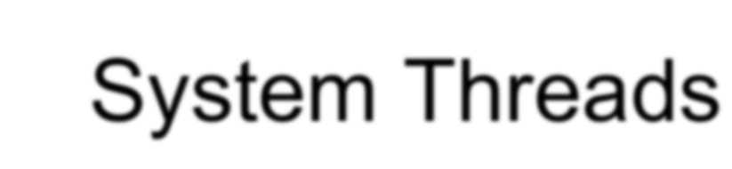

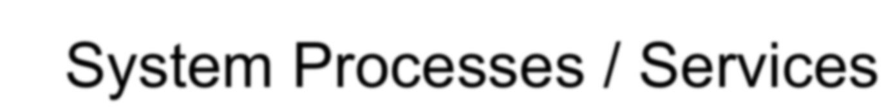
Roadmap for This Lecture
Architecture Overview
Key windows system files Design Attributes and Features
Key System Components System Threads
System Processes / Services

Slide 3
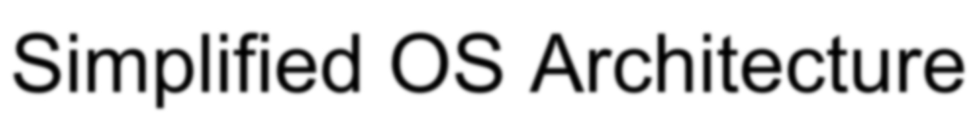
Simplified OS Architecture
System support processes
Service processes
User applications
Environment subsystems
User Mode
Subsystem DLLs
Kernel Mode
Executive
Kernel | Device drivers
Hardware Abstraction Layer (HAL)
Windowing and graphics

Slide 4



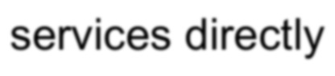

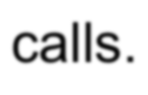





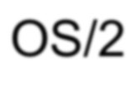





OS Architecture
Multiple personality OS design
user applications don't call the native Windows operating system services directly
Subsystem DLLs is to translate a documented function into the appropriate internal (and undocumented) Windows system service calls.
Environment subsystem processes
Manage client processes in their world
Impose semantics such as process model, security
Originally three environment subsystems: Windows, POSIX, and OS/2
POSIX: Portable Operating System Interface for Unix
Windows 2000 only included Windows and POSIX Windows XP only includes Windows
Enhanced POSIX subsystem available with Services for Unix Included with Windows Server 2003 R2

Slide 5






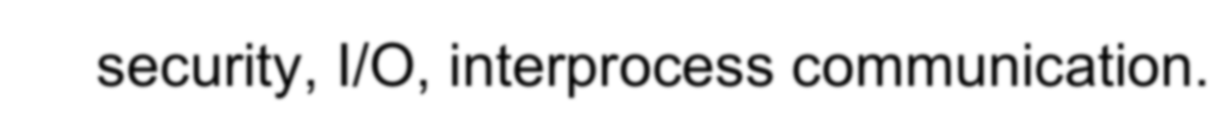

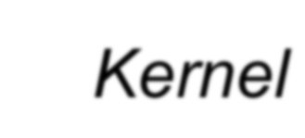

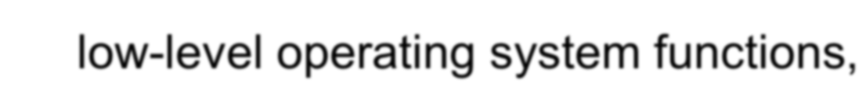

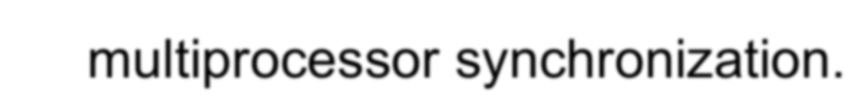




Kernel-Mode Components: Core OS
Executive
base operating system services,
memory management, process and thread management, security, I/O, interprocess communication.
Kernel
low-level operating system functions,
thread scheduling, interrupt and exception dispatching, multiprocessor synchronization.
provides a set of routines and basic objects that the rest of the executive uses to implement higher-level constructs.
Both contained in file Ntoskrnl.exe

Slide 6


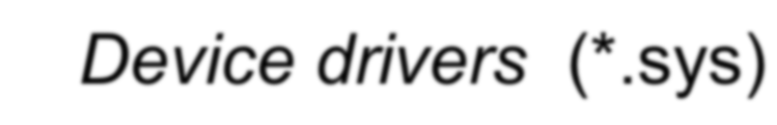

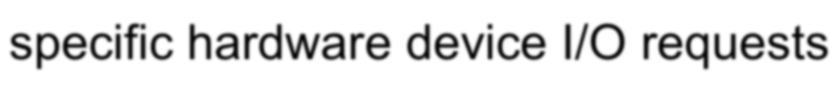




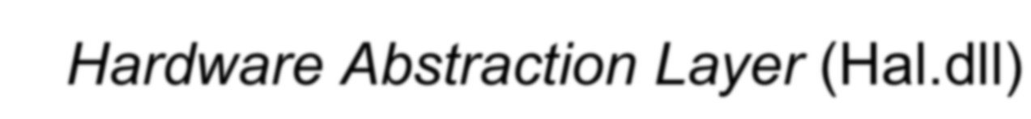

Kernel-Mode Components: Drivers
Device drivers (*.sys)
hardware device drivers translate user I/O function calls into specific hardware device I/O requests
virtual devices - system volumes and network protocols
Windowing and Graphics Driver (Win32k.sys)
graphical user interface (GUI) functions (USER and GDI) windows, user interface controls, and drawing
Hardware Abstraction Layer (Hal.dll)
isolates the kernel, device drivers, and executive from hardware Hides platform-specific hardware differences (motherboards)

Slide 7
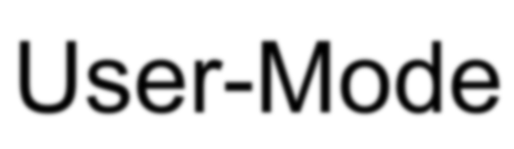
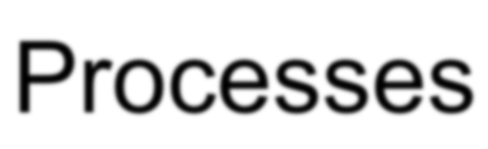
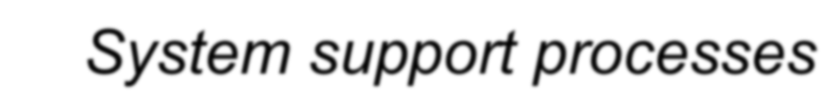
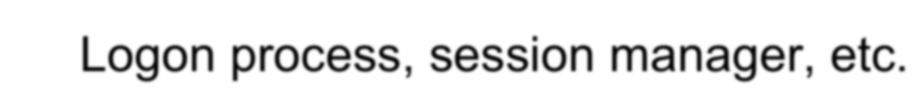

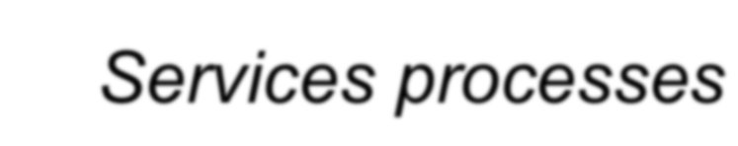


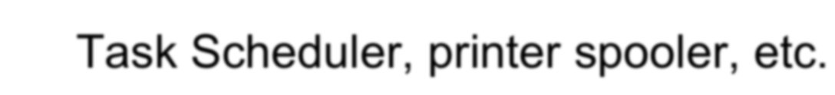


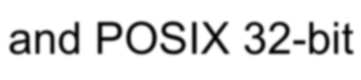
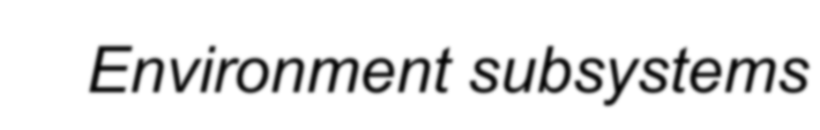




User-Mode Processes
System support processes
Logon process, session manager, etc.
Services processes
Windows services independent of user logons Task Scheduler, printer spooler, etc.
User applications
Windows 32-bit, 64-bit, Windows 3.1 16-bit, MS-DOS 16-bit and POSIX 32-bit
Environment subsystems
OS environment a.k.a. personalities
Windows, POSIX, OS/2 (dropped after Windows 2000)

Slide 8
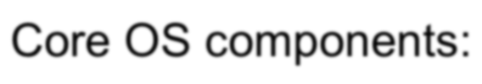



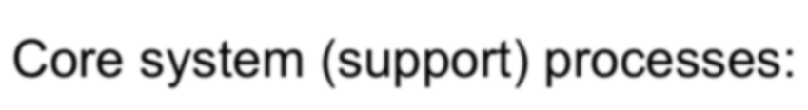



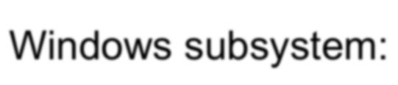



Key Windows System Files
Core OS components: NTOSKRNL.EXE** HAL.DLL NTDLL.DLL
Core system (support) processes:
SMSS.EXE WINLOGON.EXE SERVICES.EXE LSASS.EXE
Windows subsystem: CSRSS.EXE* WIN32K.SYS
KERNEL32/USER32/GDI32.DLL
Executive and kernel Hardware abstraction layer
Internal support functions and system service dispatch stubs to executive functions
Session manager process Logon process
Service controller process
Local Security Authority Subsystem
Windows subsystem process
USER and GDI kernel-mode components Windows subsystem DLLs

Slide 9






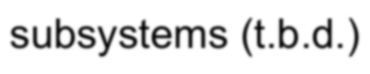
















NTOSKRNL.EXE
Core operating system image
contains Executive & Kernel
Also includes entry points for routines actually implemented in Hal.Dll
Many functions are exposed to user mode via NtDll.Dll and the environment subsystems (t.b.d.)
Four retail variations:
NTOSKRNL.EXE NTKRNLMP.EXE
Uniprocessor Multiprocessor
Windows 2000 adds PAE (page address extension) versions – must boot /PAE (32-bit Windows only); also used for processors with hardware no execute support (explained in Memory Management unit)
NTKRNLPA.EXE NTKRPAMP.EXE
Uniprocessor w/extended addressing support Multiprocessor w/extended addressing support
Two checked build (debug) variations:
NTOSKRNL.EXE,
NTKRNLMP.EXE NTKRNLPA.EXE, NTKRPAMP.EXE
Debug multiprocessor
Debug multiprocessor w/extended addressing

Slide 10


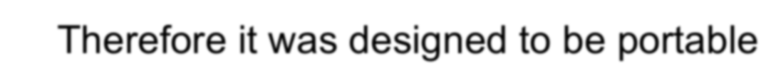




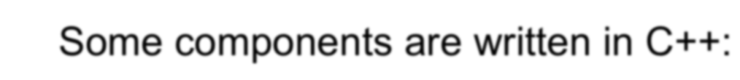



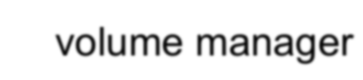





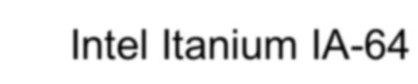

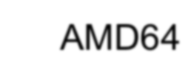

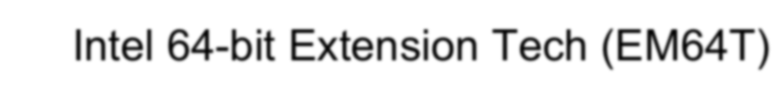

Portability
When Windows NT was designed, there was no dominant processor architecture
Therefore it was designed to be portable
How achieved?
Most Windows OS code and device drivers is written in C
HAL and kernel contain some assembly language
Some components are written in C++:
windowing/graphics subsystem driver volume manager
Hardware-specific code is isolated in low level layers of the OS (such as Kernel and the HAL)
Provides portable interface
XP and Server 2003 support
Intel Itanium IA-64 AMD64
Intel 64-bit Extension Tech (EM64T)

Slide 11


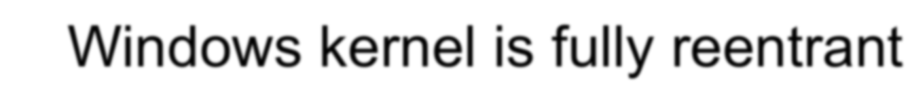

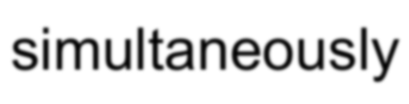

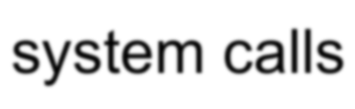
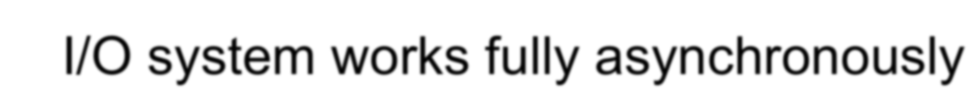



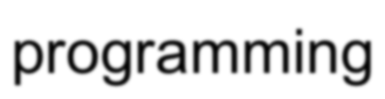
Reentrant and Asynchronous Operation
Windows kernel is fully reentrant
Kernel functions can be invoked by multiple threads simultaneously
No serialization of user threads when performing system calls
I/O system works fully asynchronously
Asynchronous I/O improves application’s throughput
Synchronous wrapper functions provide ease-of- programming

Slide 12
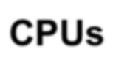





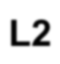

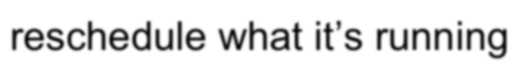








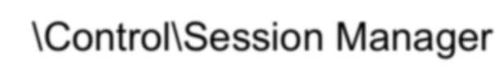

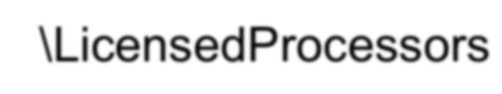







Symmetric Multiprocessing (SMP)
CPUs
No master processor
All the processors share just one memory space Interrupts can be serviced on any processor
Any processor can cause another processor to reschedule what it’s running
Maximum # of CPUs stored in registry
HKLM\System\CurrentControlSet
\Control\Session Manager
\LicensedProcessors
L2
Cache
Memory
I/O
SMP
Current implementation limit is # of bits in a native word
32 processors for 32-bit systems 64 processors for 64-bit systems
Not an architectural limit—just implementation

Slide 13



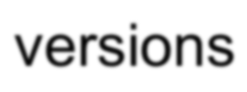
UP vs MP File Differences
These files are updated when moving from UP to MP:
Name of file on system disk | Name of uniprocessor version on CD-ROM | Name of multiprocessor version on CD-ROM
NTOSKRNL.EXE | \I386\NTOSKRNL.EXE | \I386\NTKRNLMP.EXE
NTKRNLPA.EXE | \I386\NTKRNLMP.EXE | \I386\NTKRPAMP.EXE
HAL.DLL | Depends on system type | Depends on system type
Everything else is the same (drivers, EXEs, DLLs)
NT4: Win32k.sys, Ntdll.dll, and Kernel32.dll had uniprocessor versions

Slide 14
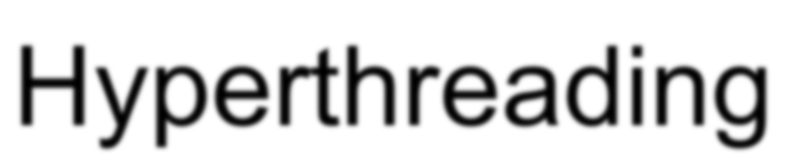



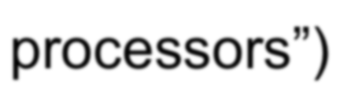


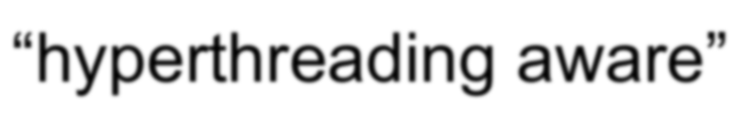


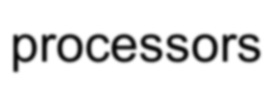

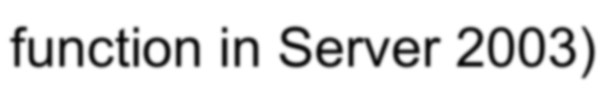
Hyperthreading
New technology in newer Intel processors
Makes a single processor appear as multi-processor to the OS Also called simultaneous multithreading technology (SMT)
Chip maintains many separate CPU states (“logical processors”)
Execution engine & onboard cache is shared
XP & Server 2003 and later Windows are “hyperthreading aware”
Logical processors don’t count against physical processor limits
Scheduling algorithms take into account logical vs physical processors
Applications can also optimize for it (new Windows function in Server 2003)

Slide 15
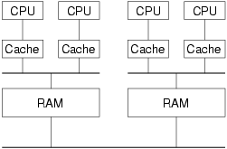


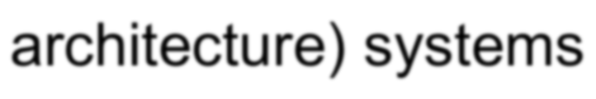


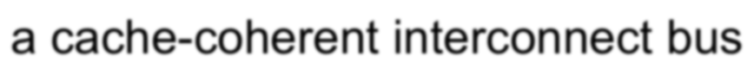





NUMA
NUMA (non uniform memory architecture) systems
Groups of physical processors (called “nodes”) that have local memory
Connected to the larger system through a cache-coherent interconnect bus
Still an SMP system (e.g. any processor can access all of memory)
But node-local memory is faster
Scheduling algorithms take this into account
Tries to schedule threads on processors within the same node
Tries to allocate memory from local memory for processes with threads on the node
New Windows APIs to allow applications to optimize

Slide 16




















SMP Scalability
Scalability is a function of parallelization and resource contention
Can’t make a general statement
Depends on what you are doing and if the code involved scales well
Kernel is scalable
OS can run on any available processor and on multiple processors at the same time
Fine-grained synchronization within the kernel as well as within
device drivers allows more components to run concurrently on multiple processors
Concurrency has improved with every release
Applications can be scalable
Threads can be scheduled on any available CPU
Processes can contain multiple threads that can execute simultaneously on multiple processors
Programming mechanisms provided to facilitate scalable server applications
Most important is I/O completion ports

Slide 17









Differences between Client and Server Versions
Number of CPUs supported (# of packages, not cores) Amount of physical memory supported
Number of concurrent networks
Support for Tablet PC and Media Center Ed.
Features like BitLocker, DVD burning, WinFax and 100+ config values
Layered services unique for Servers, e.g. directory services and clustering

Slide 18







Built On the Same Core OS
Through Windows 2000, core operating system executables were identical
NTOSKRNL.EXE, HAL.DLL, xxxDRIVER.SYS, etc.
As stated earlier, XP & Server 2003 have different kernel versions
Registry indicates system type (set at install time)
HKEY_LOCAL_MACHINE\System\CurrentControlSet\Control
\ProductOptions
ProductType: WinNT=Workstation, ServerNT=Server not a domain controller, LanManNT=Server that is a Domain Controller
ProductSuite: indicates type of Server (Advanced, Datacenter, or for NT4: Enterprise Edition, Terminal Server, …)

Slide 19





Built On the Same Core OS (Cont’d)
Code in the operating system tests these values and behaves slightly differently in a few places
Licensing limits (number of processors, number of network connections, etc.)
Boot-time calculations (mostly in the memory manager) Default length of time slice
See DDK: MmIsThisAnNtasSystem (check if it’s server)

Slide 20















Debug Version (“Checked Build”)
Special debug version of system called “Checked Build”
Multiprocessor versions only (runs on UP systems)
helps catch synchronization bugs that are more visible on MP systems
Primarily for driver testing, but can be useful for catching timing bugs in multithreaded applications
Built from same source files as “free build” (aka “retail build”)
But with “DBG” compile-time symbol defined This enables:
error tests for “can’t happen” conditions in kernel mode (ASSERTs)
validity checks on arguments passed from one kernel mode routine to another
#ifdef DBG
if (something that should never happen has happened) KeBugCheckEx(…)
#endif
Since no checked Windows 2000 Server provided, can copy checked NTOSKRNL, HAL, to a normal Server system
Select debug kernel & HAL with Boot.ini /KERNEL=, /HAL= switches
Windows Server 2003 has its own checked build
See Knowledge base article 314743 (HOWTO: Enable Verbose Debug Tracing in Various Drivers and Subsystems)

Slide 21

Key System Components
Environment Subsystems
 |  | System & Service
 |  | Processes
 |  | Windows DLL
User
Application
POSIX
Windows
User
Subsystem DLL
Windows
Mode
Kernel Mode
Executive
Windows User/GDI
Device Driver
Device Drivers
Kernel
Hardware Abstraction Layer (HAL)

Slide 22














Multiple OS Personalities
Windows was designed to support multiple “personalities”, called environment subsystems
Programming interface File system syntax Process semantics
Environment subsystems provide exposed, documented interface between application and Windows native API
Each subsystem defines a different set of APIs and semantics Subsystems implement these by invoking native APIs
Example: Windows CreateFile in Kernel32.Dll calls native NtCreateFile
.exes and .dlls you write are associated with a subsystem
Specified by LINK /SUBSYSTEM option Cannot mix calls between subsystems

Slide 23


















Environment Subsystems
Three environment subsystems originally provided with NT: Windows –Windows API (originally 32-bit, now also 64-bit) OS/2 - 1.x character-mode apps only
Removed in Windows 2000
Posix - only Posix 1003.1 (bare minimum Unix services - no networking, windowing, threads, etc.)
Removed in XP/Server 2003 – enhanced version ships with Services For Unix 3.0
Of the three, the Windows subsystem provides access to the majority of native OS functions
Of the three, Windows is required to be running
System crashes if Windows subsystem process exits
POSIX and OS/2 subsystems are actually Windows applications POSIX & OS/2 start on demand (first time an app is run)
Stay running until system shutdown

Slide 24








App calls Subsystem
Function entirely implemented in user mode
No message sent to environment subsystem process No Windows executive system service called Examples: PtInRect(), IsRectEmpty()
Function requires one/more calls to Windows executive
Examples: Windows ReadFile() / WriteFile() implemented using I/O system services NtReadFile() / NtWriteFile()
Function requires some work in environment subsystem process (maintain state of client app)
Client/server request (message) to env. Subsystem (LPC facility) Subsystem DLL waits for reply before returning to caller
Combinations of 2/3: CreateProcess() / CreateThread()

Slide 25









Windows Subsystem
Environment subsystem process (CSRSS.EXE):
Console (text) windows
Creating and deleting processes and threads
Portions of the support for 16-bit virtual DOS machine (VDM) Other func: GetTempFile, DefineDosDevice, ExitWindowsEx
Kernel-mode device driver (WIN32K.SYS):
Window manager: manages screen output; input from keyboard, mouse, and other devices user messages to applications.
Graphical Device Interface (GDI)

Slide 26






Windows Subsystem (contd.)
Subsystem DLLs (such as USER32.DLL, ADVAPI32.DLL, GDI32.DLL, and KERNEL32.DLL)
Translate Windows API functions into calls to NTOSKRNL.EXE and WIN32K.SYS.
Graphics device drivers
graphics display drivers, printer drivers, video miniport drivers
Prior to Windows NT 4.0, the window manager and graphics services were part of the user-mode Win32 subsystem process.
Is Windows Less Stable with Win32 USER and GDI in Kernel Mode?

Slide 27


























Executive
Upper layer of the operating system
Provides “generic operating system” functions (“services”)
Process Manager Object Manager Cache Manager
LPC (local procedure call) Facility Configuration Manager
Memory Manager
Security Reference Monitor I/O Manager
Power Manager
Plug-and-Play Manager
Almost completely portable C code
Runs in kernel (“privileged”, ring 0) mode
Most interfaces to executive services not documented

Slide 28














Kernel
Lower layers of the operating system
Implements processor-dependent functions (x86 vs. Itanium etc.)
Also implements many processor-independent functions that are closely associated with processor-dependent functions
Main services
Thread waiting, scheduling & context switching Exception and interrupt dispatching
Operating system synchronization primitives (different for MP vs. UP)
A few of these are exposed to user mode
Not a classic “microkernel”
shares address space with rest of kernel-mode components

Slide 29











HAL - Hardware Abstraction Layer
Responsible for a small part of “hardware abstraction” Components on the motherboard not handled by drivers
System timers, Cache coherency, and flushing SMP support, Hardware interrupt priorities
Subroutine library for the kernel & device drivers
Isolates Kernel and Executive from platform-specific details Presents uniform model of I/O hardware interface to drivers
Reduced role as of Windows 2000
Bus support moved to bus drivers Majority of HALs are vendor-independent

Slide 30











HAL - Hardware Abstraction Layer (Cont’d)
HAL also implements some functions that appear to be in the Executive and Kernel
Selected at installation time
See \windows\repair\setup.log to find out which one Can select manually at boot time with /HAL= in boot.ini
HAL kit
Special kit only for vendors that must write custom HALs (requires approval from Microsoft)
see http://www.microsoft.com/whdc/ddk/HALkit/default.mspx
Sample HAL routines:
HalGetInterruptVector HalGetAdapter WRITE_PORT_UCHAR

Slide 31



















Kernel-Mode Device Drivers
Separate loadable modules (drivername.SYS)
Linked like .EXEs
Typically linked against NTOSKRNL.EXE and HAL.DLL
Only one version of each driver binary for both uniprocessor (UP) and multiprocessor (MP) systems…
… but drivers call routines in the kernel that behave differently for UP vs. MP Versions
Defined in registry
Same area as Windows services (t.b.d.) - differentiated by Type value
Several types:
“ordinary”, file system, NDIS miniport, SCSI miniport (linked against port drivers), bus drivers
More information in I/O subsystem section
To view loaded drivers, run drivers.exe
Also see list at end of output from pstat.exe – includes addresses of each driver
To update & control:
System properties→Hardware Tab→Device Manager Computer Management→Software Environment→Drivers

Slide 32

Windows Architecture
System Processes
Services
Applications
Environment Subsystems
Service Control Mgr.
SvcHost.Exe
Task Manager
Windows
LSASS
WinMgt.Exe
WinLogon
Explorer
SpoolSv.Exe
User
User Mode
Services.Exe
Application
Session Manager
POSIX
Subsystem DLLs
Windows DLLs
System Threads
NTDLL.DLL
Kernel
Mode
System Service Dispatcher
(kernel mode callable interfaces)
Windows USER, GDI
I/O Mgr
File System Cache
Object Mgr.
Plug and Play Mgr.
Power Mgr.
Security Reference Monitor
Virtual Memory
Processes &
Threads
Configura- tion Mgr (registry)
Local Procedure Call
Device & File Sys. Drivers
Graphics Drivers
Kernel
Hardware Abstraction Layer (HAL)
hardware interfaces (buses, I/O devices, interrupts, interval timers, DMA, memory cache control, etc., etc.)
Original copyright by Microsoft Corporation.
Used by permission.

Slide 33













Background System Processes
Core system processes,
logon process, the session manager, etc. not started by the service control manager
Service processes
Host Windows services
i.e.; Task Scheduler and Spooler services
Many Windows server applications, such as Microsoft SQL Server and Microsoft Exchange Server, also include components that run as services.

Slide 34






System Threads
Functions in OS and some drivers that need to run as real threads
E.g., need to run concurrently with other system activity, wait on timers, perform background “housekeeping” work
Always run in kernel mode
Preemptible (unless they raise IRQL to 2 or above)
For details, see DDK documentation on PsCreateSystemThread
What process do they appear in?
“System” process (NT4: PID 2, W2K: PID 8, XP: PID 4)
In Windows 2000 & later, windowing system threads (from Win32k.sys) appear in “csrss.exe” (Windows subsystem process)

Slide 35
























Examples of System Threads
Memory Manager
Modified Page Writer for mapped files Modified Page Writer for paging files Balance Set Manager
Swapper (kernel stack, working sets) Zero page thread (thread 0, priority 0)
Security Reference Monitor
Command Server Thread
Network
Redirector and Server Worker Threads
Threads created by drivers for their exclusive use
Examples: Floppy driver, parallel port driver
Pool of Executive Worker Threads
Used by drivers, file systems, …
Work queued using ExQueueWorkItem
System thread (ExpWorkerThreadBalanceManager) manages pool

Slide 36






















Identifying System Threads: Process Explorer
With Process Explorer:
Double click on System process
Go to Threads tab – sort by CPU time
As explained before, threads run between clock ticks (or at high IRQL) and thus don’t appear to run
Sort by context switch delta column
Cswitch Delta: number of context switches per Process Explorer refresh interval

Slide 37

















Process-Based Code
OS components that run in separate executables (.exe’s), in their own processes
Started by system
Not tied to a user logon
Three types:
Environment Subsystems (already described)
System startup processes
note, “system startup processes” is not an official MS-defined name
Windows Services
Let’s examine the system process “tree”
Use Tlist /T or Process Explorer

Slide 38









System Startup Processes
First two processes aren’t real processes
not running a user mode .EXE no user-mode address space
different utilities report them with different names
data structures for these processes (and their initial threads) are “pre- created” in NtosKrnl.Exe and loaded along with the code
(Idle)
Process id 0
Part of the loaded system image
Home for idle thread(s) (not a real process nor real threads)
Called “System Process” in many displays
Process id 2 (8 in Windows 2000; 4 in XP)
Part of the loaded system image
Home for kernel-defined threads (not a real process) Thread 0 (routine name Phase1 Initialization) launches the first “real” process, running smss.exe...
...and then becomes the zero page thread
(System)

Slide 39








System Startup Processes (cont.)
smss.exe
Session Manager
The first “created” process
Takes parameters from \HKEY_LOCAL_MACHINE\System
\CurrentControlSet
\Control\Session Manager
Launches required subsystems (csrss) and then winlogon
Windows subsystem
csrss.exe
winlogon.exe
Logon process: Launches services.exe & lsass.exe; presents first login prompt
When someone logs in, launches apps in \Software\Microsoft\Windows
NT\WinLogon\Userinit
Service Controller; also, home for many Windows-supplied services Starts processes for services not part of services.exe (driven by \Registry
\Machine\System\CurrentControlSet\Services )
Local Security Authentication Server
Started after logon; starts Explorer.exe (see \Software\Microsoft\Windows NT\CurrentVersion\WinLogon\Shell) and exits (hence Explorer appears to be an orphan)
and its children are the creators of all interactive apps
services.exe
lsass.exe userinit.exe
explorer.exe

Slide 40























Where are Services Defined?
Defined in the registry:
HKEY_LOCAL_MACHINE\SYSTEM\CurrentControlSet\Services
one key per installed service
Mandatory information kept on each service:
Type of service (Windows, Driver, ...) Imagename of service .EXE
Note: some .EXEs contain more than one service Start type (automatic, manual, or disabled)
Optional information:
Display Name
New in W2K: Description Dependencies
Account & password to run under
Can store application-specific configuration parameters
“Parameters” subkey under service key

Slide 41


















Life of a Service
Install time
Setup application tells Service Controller about the service
Setup Application
Registry
CreateService
System boot/initialization
SCM reads registry, starts services as directed
Management/maintenance
Control panel can start and stop services and change startup parameters
Service Controller/ Manager (Services.Exe)
 |  | Service
 | Processes
Control Panel

Slide 42




Process Explorer: Service Information
Process Explorer identifies Service Processes
Click on Options->Highlight Services

Slide 43










Service Processes
A process created & managed by the Service Control Manager (Services.exe)
Similar in concept to Unix daemon processes
Typically configured to start at boot time (if started while logged on, survive logoff)
Typically do not interact with the desktop
Note: Prior to Windows 2000 this was the only way to start a process on a remote machine
Now you can do it with WMI (Win Management Instrumentation)

Slide 44















Service Control Tools
Net start/stop – local system only
Sc.exe (built in to XP/2003; also in Win2000 Resource Kit)
Command line interface to all service control/configuration functions Works on local or remote systems
Psservice (Sysinternals) – similar to SC Other tools in Resource Kit
Instsrv.exe – install/remove services (command line) Srvinstw.exe – install/remove services (GUI)
Why are service creation tools included in Reskit?
Because Reskit comes with several services that are not installed as services when you install the Reskit

Slide 45
















Services Infrastructure
Windows 2000 introduced generic Svchost.exe
Groups services into fewer processes
Improves system startup time Conserves system virtual memory
Not user-configurable as to which services go in which processes 3rd parties cannot add services to Svchost.exe processes
Windows XP/2003 have more Svchost processes due to two new less privileged accounts for built-in services
LOCAL SERVICE, NETWORK SERVICE
Less rights than SYSTEM account
Reduces possibility of damage if system compromised
On XP/2003, four Svchost processes (at least):
SYSTEM
SYSTEM (2nd instance – for RPC) LOCAL SERVICE
NETWORK SERVICE

Slide 46








Lab: Which version of NTOSKRNL?
Programs/ Administrative Tools/Event Viewer
Select System Log
Double-click an Event Log entry with an Event ID of 6009
Check if it’s booted with PAE version(win2000 or winXp):
Registry entry: HKLM\SYSTEM\CurrentControlSet\Control
\SystemStartOptions
Uniprocess or multiprocessor:
right-click on Ntoskrnl.exe in your \Windows\System32 folder, and select Properties

Slide 47













Lab: Task Manager (Set Priority, etc. )
Processes tab: List of processes
Applications tab: List of top level visible windows
“Running” means waiting for window messages
Right-click on a window and select “Go to process”

Slide 48


Lab: Identifying System Threads in the System Process (Process Explorer)
You can see that the threads inside the System process must be kernel-mode system threads because the start address for each thread is greater than the start address of system space (which by default begins at 0x80000000, unless the system was booted with the /3GB Boot.ini switch).
Also, if you look at the CPU time for these threads, you’ll see that those that have accumulated any CPU time have run only in kernel mode. To find out which driver created the system thread, look up the start address of the thread (which you can display with Pviewer.exe) and look for the driver whose base address is closest to (but before) the start address of the thread. Both the Pstat utility (at the end of its output) as well as the !drivers kernel debugger command list the base address of each loaded device driver.

Slide 49




Lab: Determining If You Are Running the Checked(debug) Build
There is no built-in tool.
However, this information is available through the “Debug” property of the Windows Management Instrumentation (WMI) Win32_OperatingSystem class. (wbemtest.exe)
The following sample Visual Basic script displays this property:
strComputer= "."
Set objWMIService = GetObject("winmgmts:" & "{impersonationLevel=impersonate}!\\" & strComputer & "\root\cimv2") Set colOperatingSystems = objWMIService.ExecQuery ("SELECT * FROM Win32_OperatingSystem")
For Each objOperatingSystem in colOperatingSystems
wscript.Echo | "Caption: | " | & objOperatingSystem.Caption
wscript.Echo | "Debug: " | & | objOperatingSystem.Debug
wscript.Echo | "Version: | " | & objOperatingSystem.Version
NEXT

Slide 50



Lab: Mapping Services to Service Processes
Tlist /S (Debugging Tools) or Tasklist /svc (XP/2003) list internal name of services inside service processes
Process Explorer shows more: external display name and description

Slide 51


















Source Code References
Windows Research Kernel sources
Processes
Threads LPC
Virtual memory Scheduler Object manager
I/O manager Synchronization Worker threads Kernel heap manager
Core components of Ntoskrnl.exe

Slide 52


Source Code References (Cont’d)
Does not include the code for these modules: Windowing system driver (Csrss.exe, Win32k.sys) Windows API DLLs (Kernel32, User32, Gdi32, etc)
Core system processes (Smss, Winlogon, Services, Lsass)

Slide 53









Further Reading
Mark E. Russinovich , et al., Windows Internals, 5th Edition, Microsoft Press, 2009.
Chapter 2 - System Architecture
Operating System Model (from pp. 34) Architecture Overview (from pp. 35) Key System Components (from pp. 49)

